Slide 1

Research Question –
Tutorial Presentation for Feedback
Date: 01 Dec 2025
Group Name: B 170

Slide 2
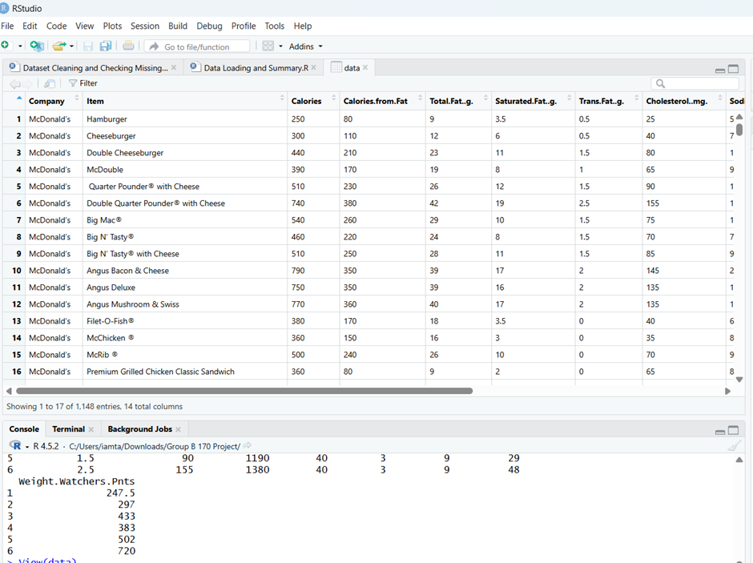
Dataset Summary

Slide 3
Is there a significant positive correlation between total fat content (grams) and calorie count in McDonald’s menu items across all product categories?
Null hypothesis (H₀): There is no significant correlation between total fat (g) and calories in McDonald’s menu items (ρ = 0).
Alternative hypothesis (H₁): There is a significant positive correlation between total fat (g) and calories in McDonald’s menu items (ρ > 0).
The Pearson correlation coefficient will be used to quantify the linear relationship and test statistical significance.
Research Question:

